Slide 1


Demo presentation
Week 4
Matyas molnar
Github : green-fox-academy/matyoo111

Slide 2
Content of presentation
Introduction
Soft skills
Coding challenge
Conclusion

Slide 3




Introduction
Mathematics and Philosophy at the University of York
Water polo
Philosophy of Science at the London School of Economics
Lifeguarding
Business Developer at FriendlyScore
FinTech Research Analyst Inter at McKinsey and Company

Slide 4
Soft skills : Stress management workshop
How to assess situations and relieve stress
Meditation
Power naps

Slide 5
Coding challenges : count letters
Count letters in a string and give back a dictionary, where the letters of the string are the keys and their frequency are the values
First, create a map, which has characters and integers in it
Then use “for loops” to count the occurrences of letters

Slide 6
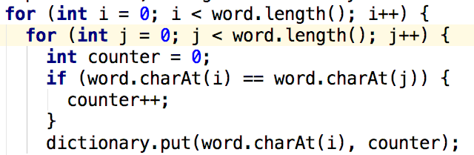
Coding challenges : count letters

Slide 7
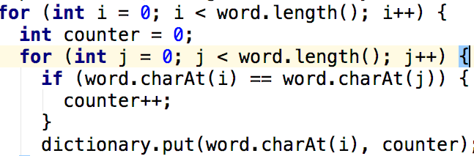
Solution

Slide 8
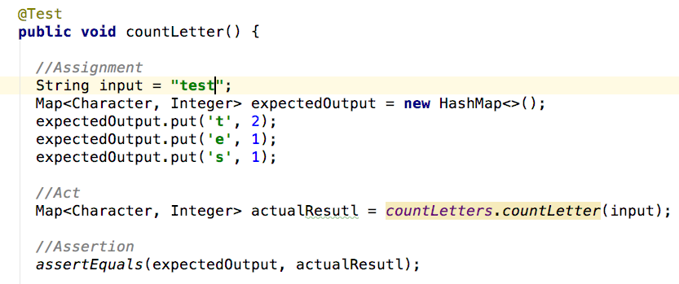
Test

Slide 9
Conclusion
Think about what your variables do when the function is running
Write tests to check whether an expected output is given

Slide 10
Thank you for watching!
Matyas molnar
Github : green-fox-academy/matyoo111
Linkedin : https://www.linkedin.com/in/molnarmatyas/

